Slide 1
*
Statistics
Data
Attack Plan
Mean Absolute Error MAE
Mean Squared Error MSE
R Squared

Slide 2

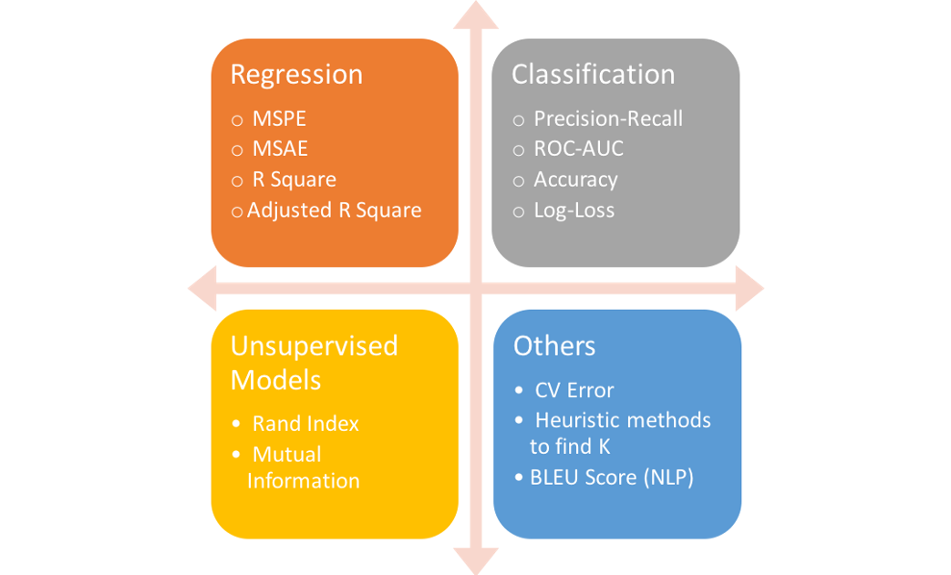

Slide 3

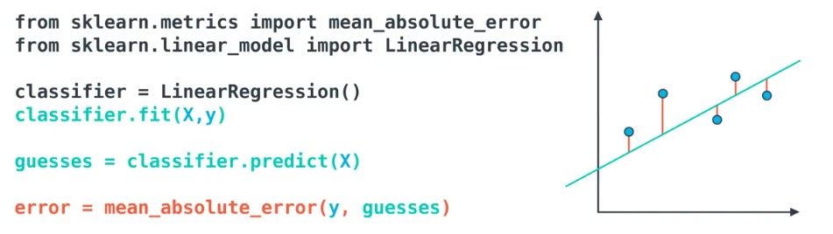
*
Mean Absolute Error MAE

Slide 4
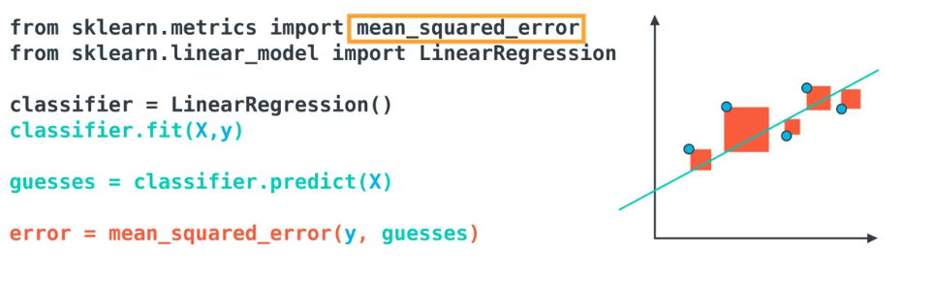
*
Mean Squared Error MSE

Slide 5
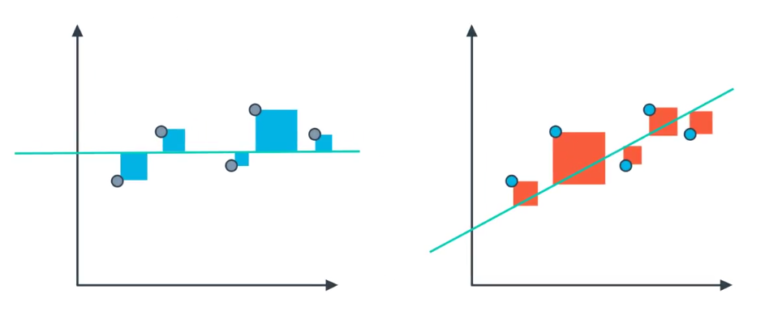
*
R Squared
R Squared
MSE
Pred
Mean

Slide 6
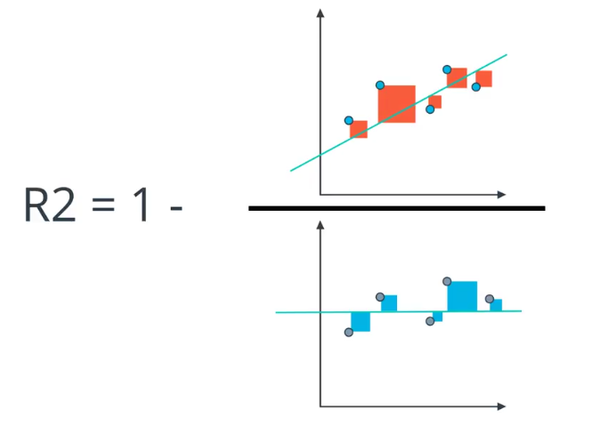
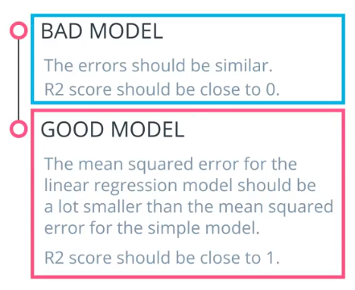
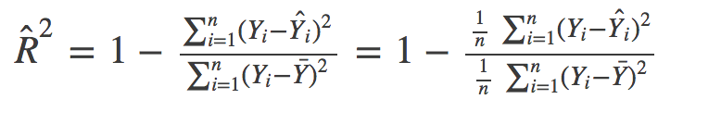
*
R Squared R2
MSE
R Squared

Slide 7
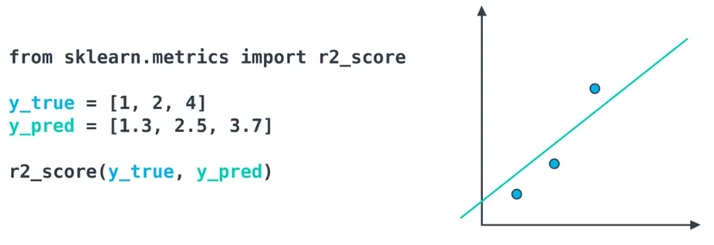
*
R Squared R2

Slide 8
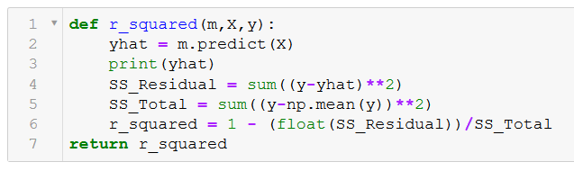
*
R Squared R2

